Slide 1
Air Quality in the United States
Lonny Kramer, Elizabeth Schilling, Ashwin Jayaram

Slide 2
Our Project
We will be showing a heat map of various air pollutants across the USA using the API from the website https://openaq.org/.
The map will show the areas that contain various amounts of the air pollutants and which areas have more.

Slide 3
Air pollutants
7 airborne pollutants:
Black Carbon
Nitrogen Dioxide
Carbon Monoxide
Ozone
PM 2.5
PM 10

Slide 4
Project Summary
Gathered data from openaq.org
Manipulated data using jupyter notebook
Eventually created app.py file, incorporated sqlite
Created our project home html page, included interactive links, drop-down menus, images and information regarding air quality
Explored various javascript libraries not covered in class
Chose a radar map from the chart.js library
Incorporated leaflet library for geomap visualization
Created a bar chart to demonstrate our data in a graph-like format

Slide 5
What we each worked on
Ashwin: API Call to Openaq. Jupyter Notebook. Converting dataframe to sqlite. Pushing sqlite to jsonify, general Javascript reformatting.
Lonny: website, motivation, cheerleader, visualizations
Elizabeth: geomap, visualizations

Slide 6
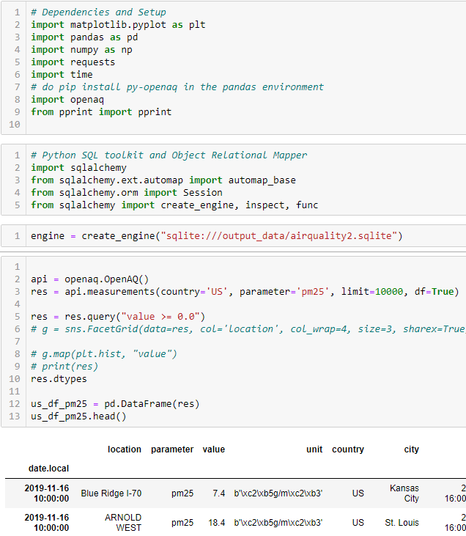
API Call to Openaq (Retrieving and cleaning the data)
To use their API, you need to install their library. The example methods did not work!
We set the country as US and searched for each pollutant by itself.
Each API call retrieved the air pollutants data for each hour. In order to get the data from as many cities as possible, we ran each each pollutant separately.
After grouping each dataframe by the city, it was added to an sqlite file.
All those dataframes were then added to each other to create a larger sqlite file.

Slide 7
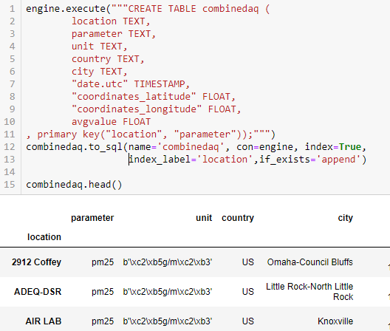
Turning Sqlite to Jsonify
The Jupyter notebook had to be edited so that each table could have primary keys (figuring out the code on the right took hours!)
There were also issues with the unit as some of the values had items that had to be decoded.

Slide 8

Issues with sqlite to Jsonify

Slide 9
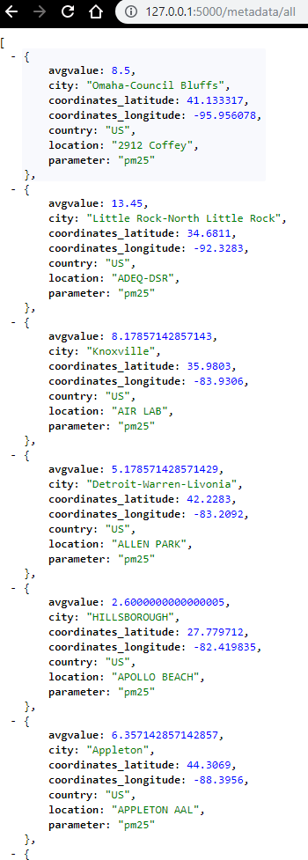
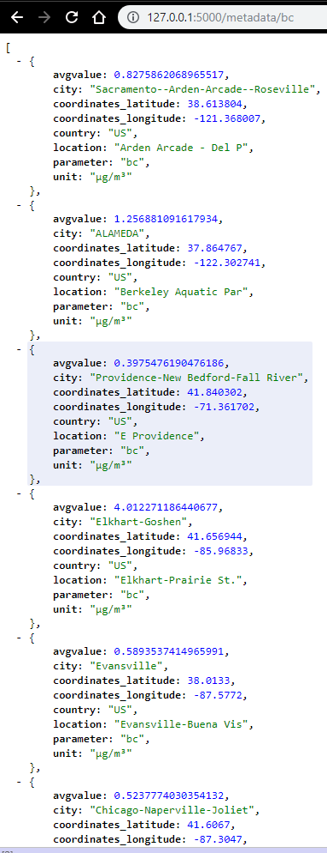
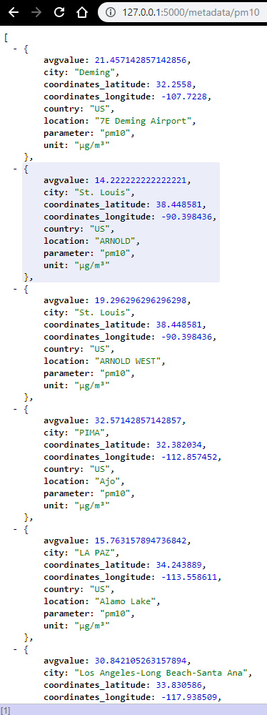
We did it!

Slide 10
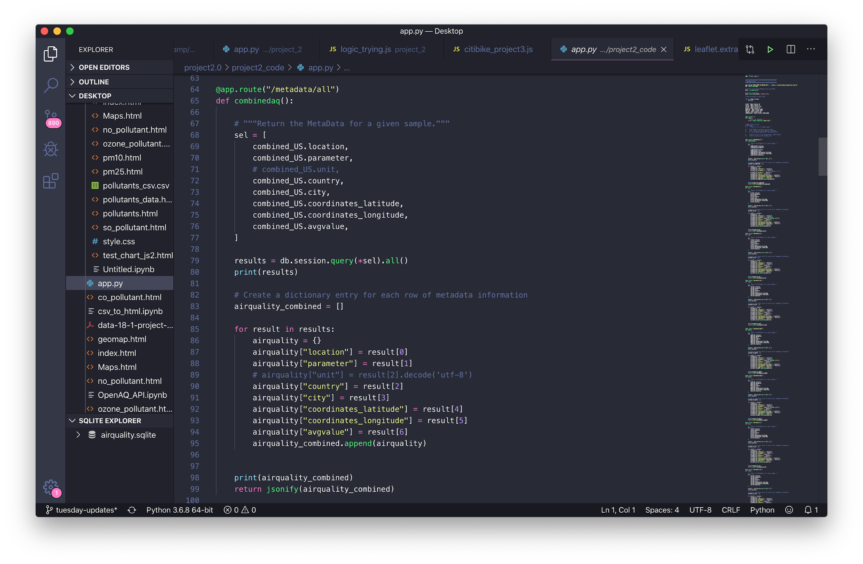

Slide 11
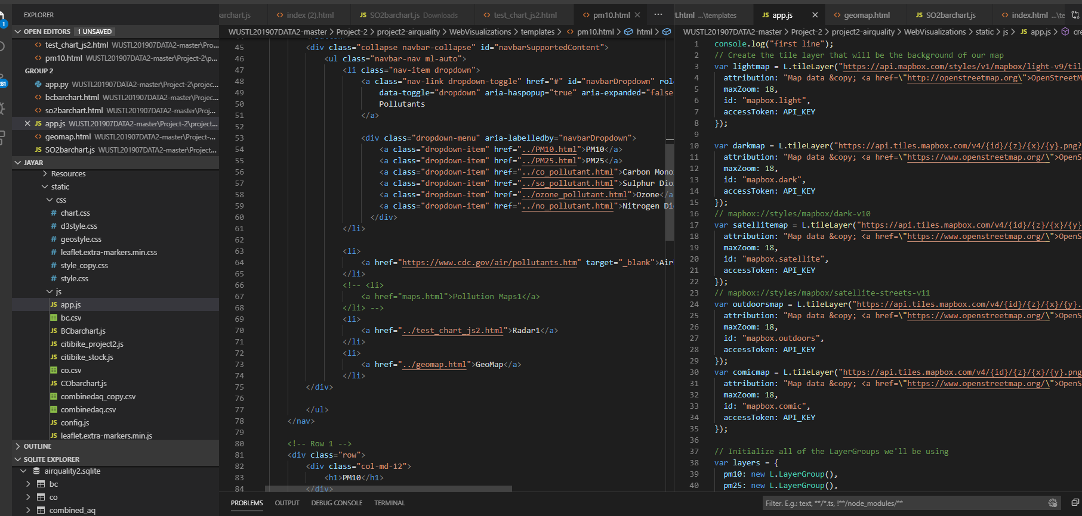
Thats a lot of tabs!

Slide 12
If we had more time...
We could have converted the pollutant into the same unit
Or kept the pollutants in their unit of measure but created a layer of the geo-map to switch between showing just the pollutants collected in ppm or micrograms
Perfected the radar map to demonstrate the pollutants with the correct units of measure (ppm or micrograms)
Added a layer to the geo-map that color coordinated the size of the circle with the larger/smaller value (a large red circle is a higher value than a small green circle)
Perfected our bar charts to have an X-axis label displaying the cities

Slide 13
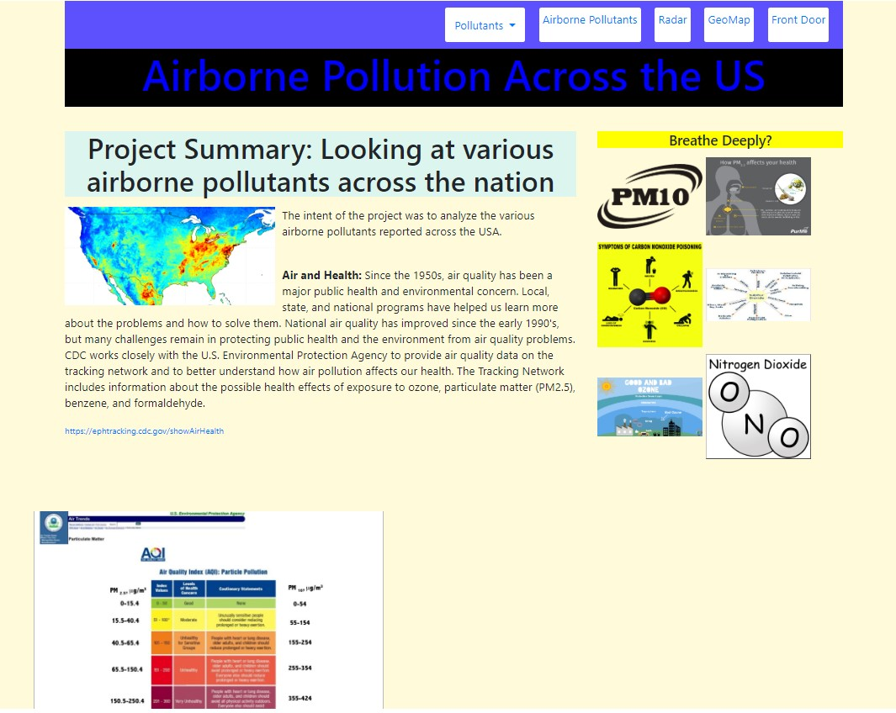
Webpage Screenshots

Slide 14
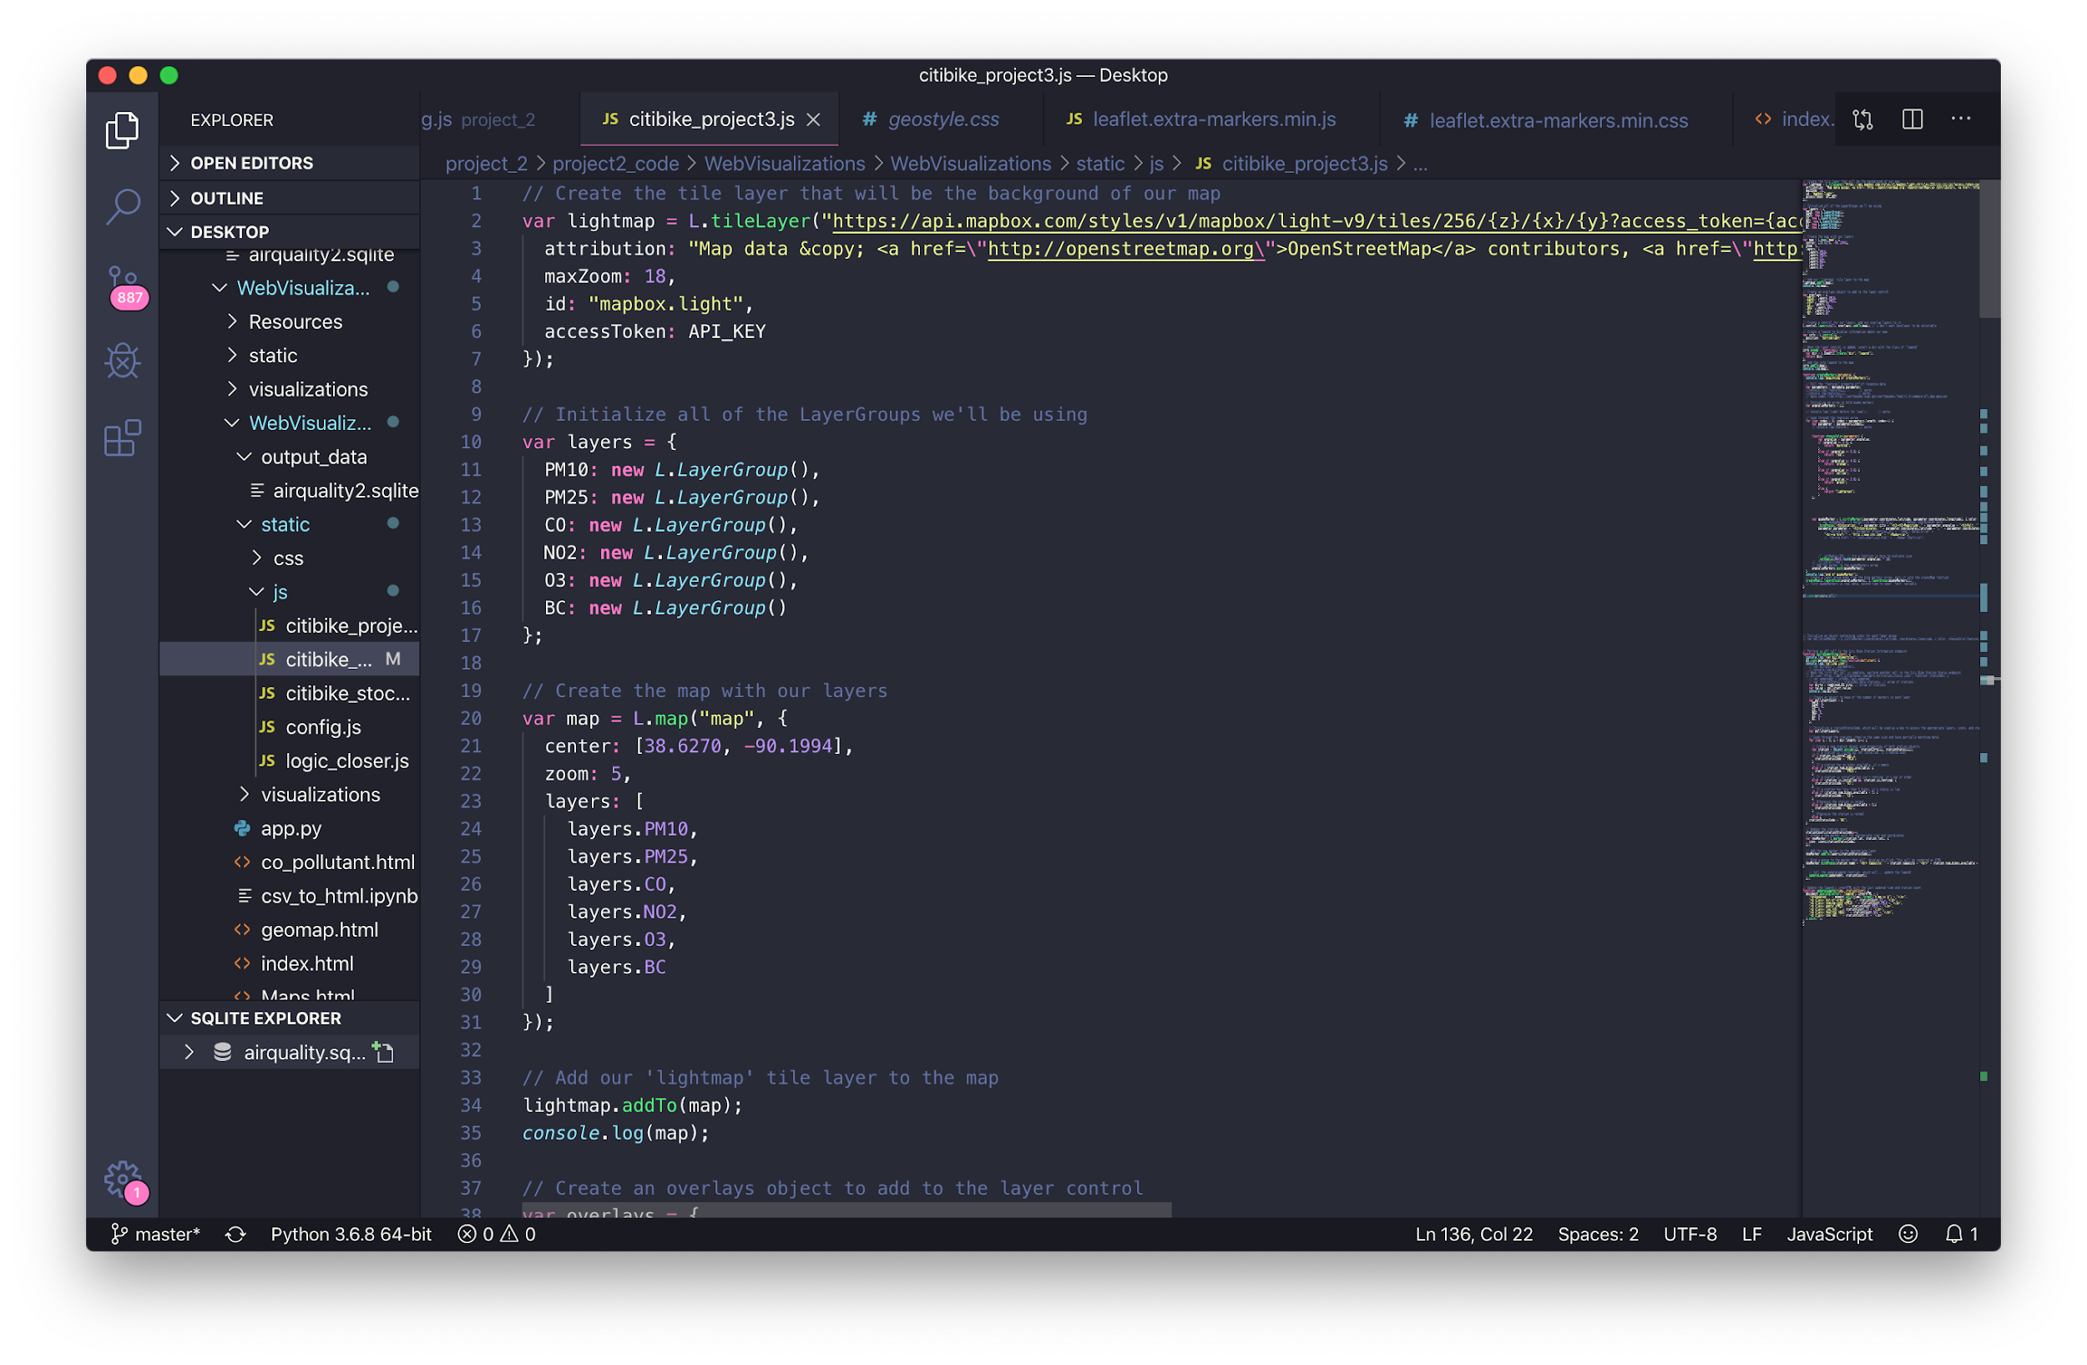

Slide 15
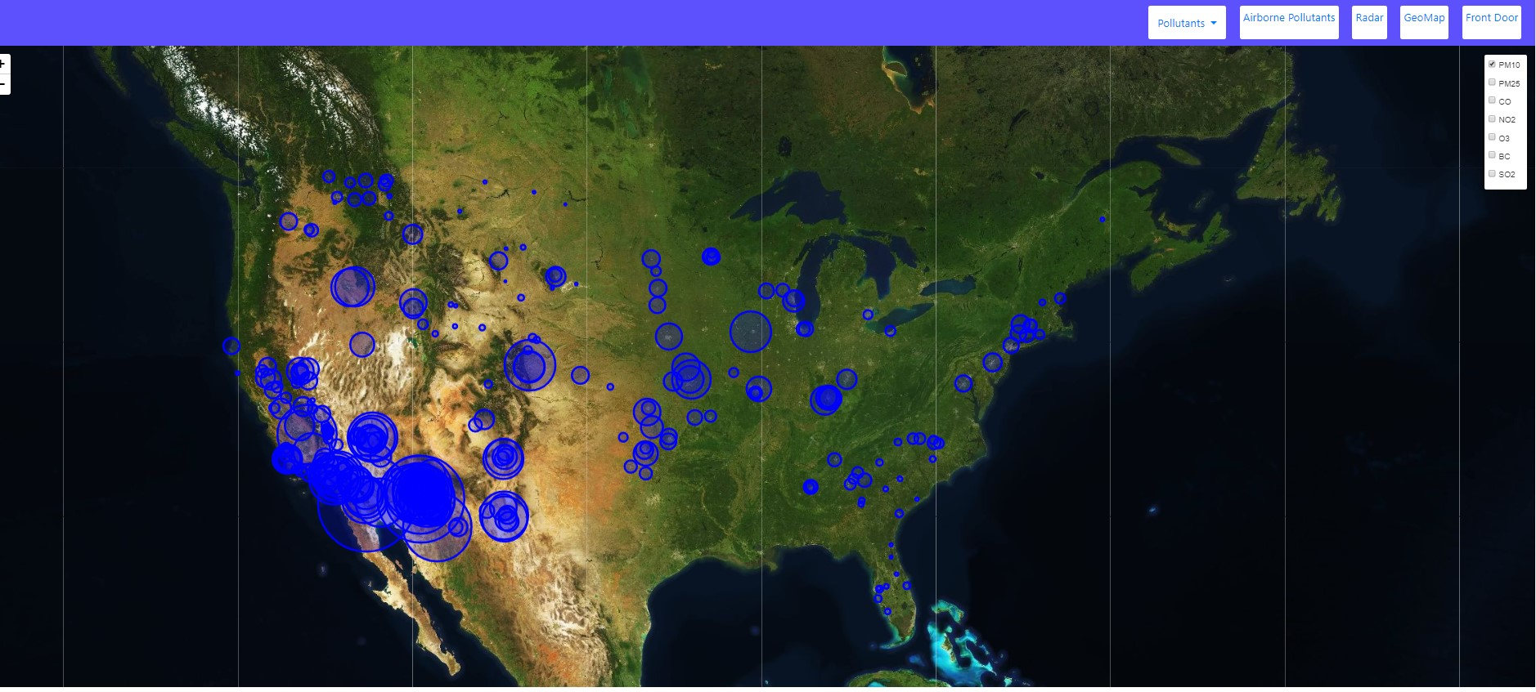
Webpage Screenshots

Slide 16
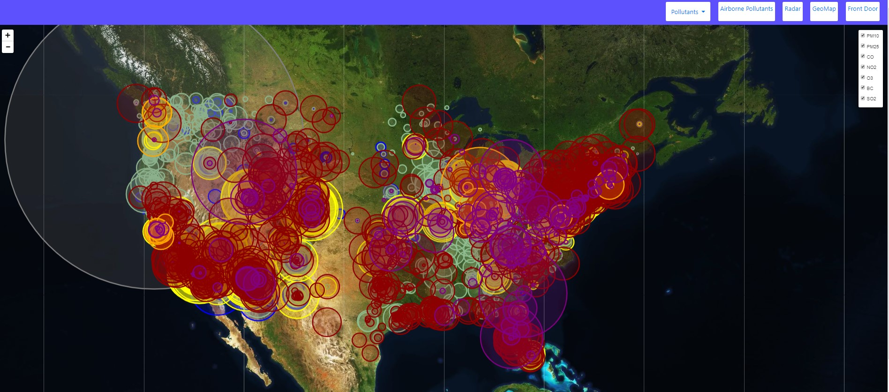
Webpage Screenshots

Slide 17
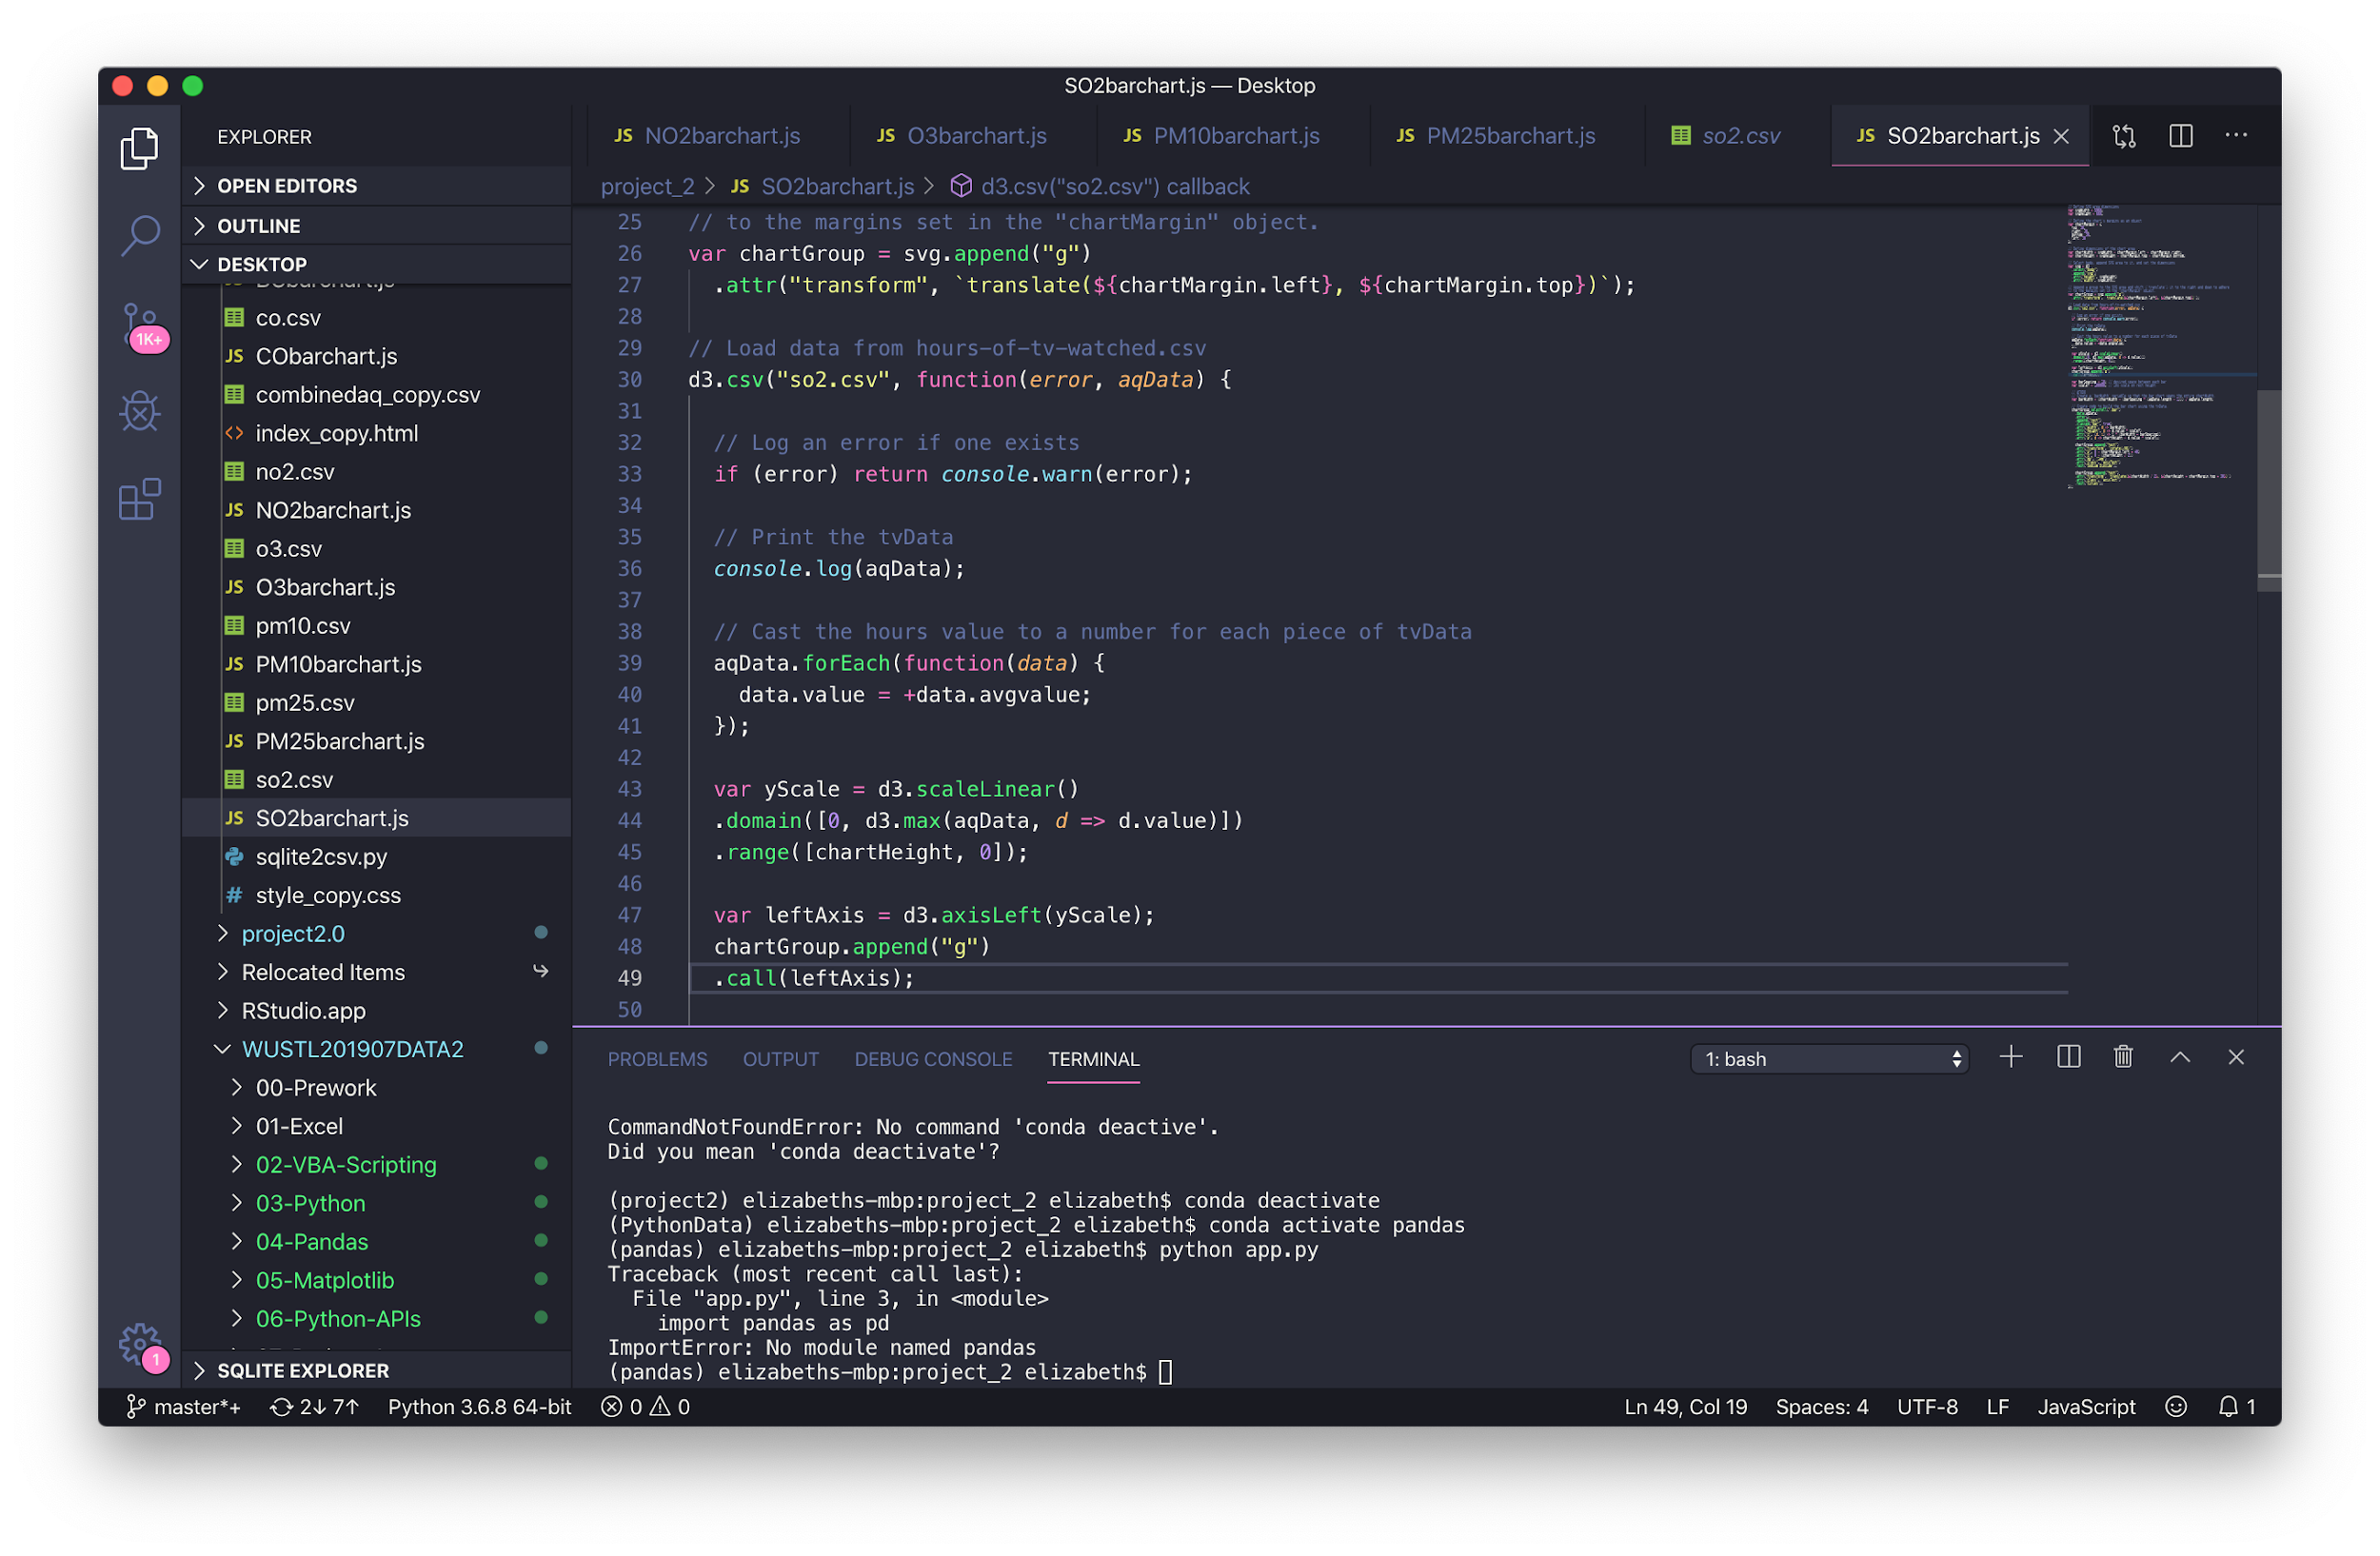

Slide 18
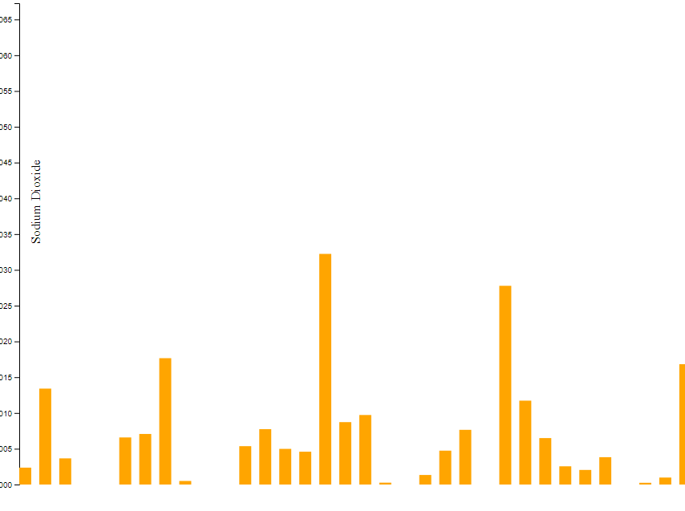
Sulphur Dioxide Bar Chart

Slide 19
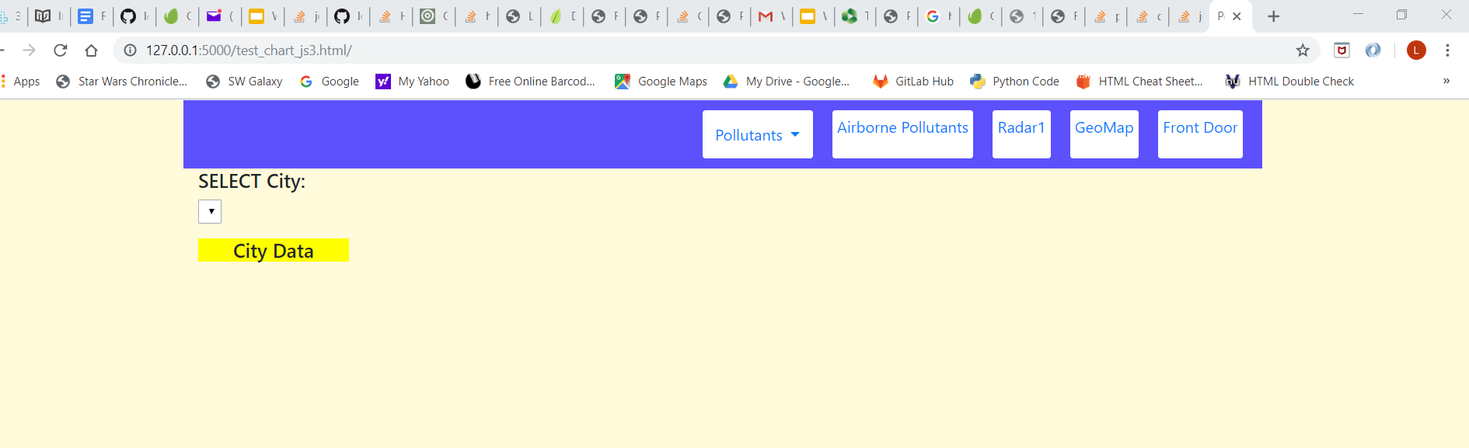
Couldn’t get the Dynamic Radar to work….
...used Belly Button as the template

Slide 20
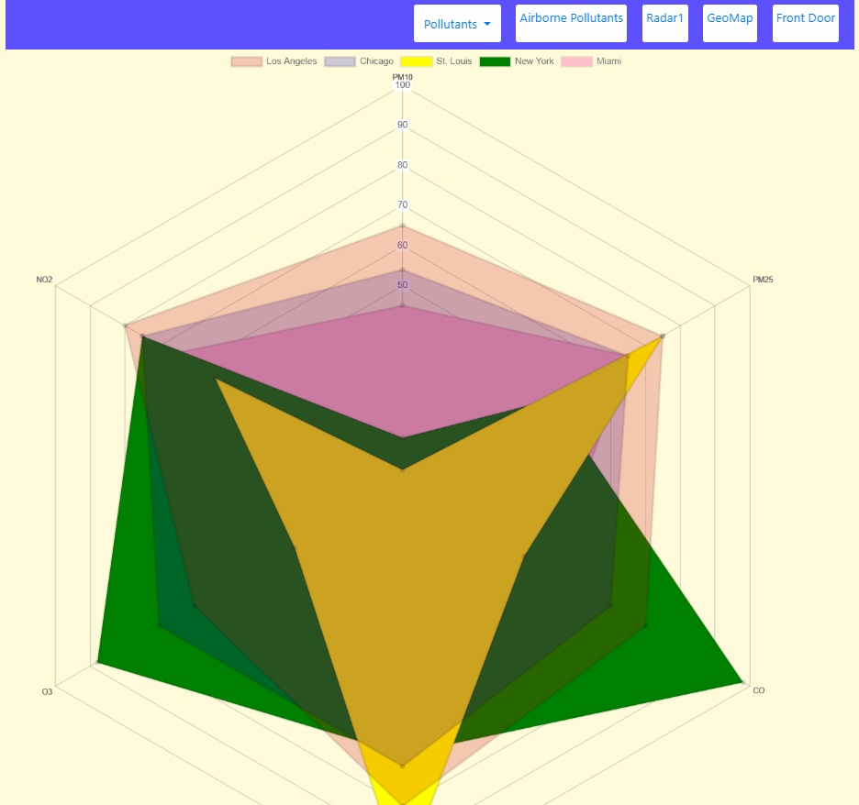
Webpage Screenshots
We loaded Chart.js to allow for more interesting charts. The radar map caught our attention most and we proceeded to build a model for representation (even with the docs and another website showing incorrect coding).
Didn’t work well:
Scaling needed to be more variable
Couldn’t get Belly Button to run and use for a template.

Slide 21
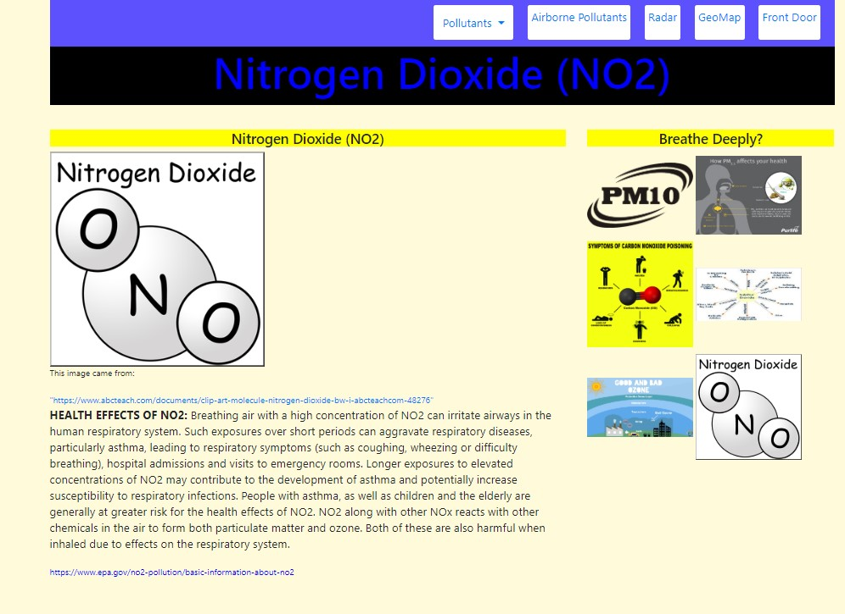
Webpage Screenshots
Each page offers information regarding the pollutant, along with links to read further information.

Slide 22
Our Story
As you can see, according to our maps and charts, air quality is an important issue across the country
The geo-map demonstrates where some pollutants are at potentially harmful amounts (shown by the larger circles)
Each layer of the map can be added or removed depending on whether the user prefers to see all 7 pollutants, or a combination of 1-6
The bar chart shows the cities on the X axis and the average value of the pollutants on the Y-axis scaled according to the maximum value within the csv file

Slide 23


